Slide 1

Applied Science and Engineering Project (ASEP)
Course Code: AI 1011
Mid Semester Review Activity Presentation
AI Attendance tracker via face recognition
Department of Engineering, Sciences and Humanities
BRACT’S, Vishwakarma Institute of Technology, Pune-37
(An Autonomous Institute affiliated to Savitribai Phule Pune University)
(NBA and NAAC accredited, ISO 9001:2015 certified)

Slide 2
Applied Science and Engineering Project 1 (ASEP1) Project_PPT for Mid Semester Assessment – November 2025
Project Title:-AI Attendance tracker via face recognition
Div:- AIDS-F ASEP1_Group No:- 4 Day:- Saturday Date:- 17-01-2026
Presented by Project Guide- Mrs. Minal Bharate
1) Soham Patil (1251010550)
2) Soham Kurulkar (1251010362)
3) Suchit Tumbada (1251010757)
4) Snehal Dhande(1251010381)
Department of Engineering, Sciences and Humanities
Vishwakarma Institute of Technology, Pune
Roll Nos. of the Students, Department of Engineering, Sciences and Humanities, VIT, Pune-37

Slide 3

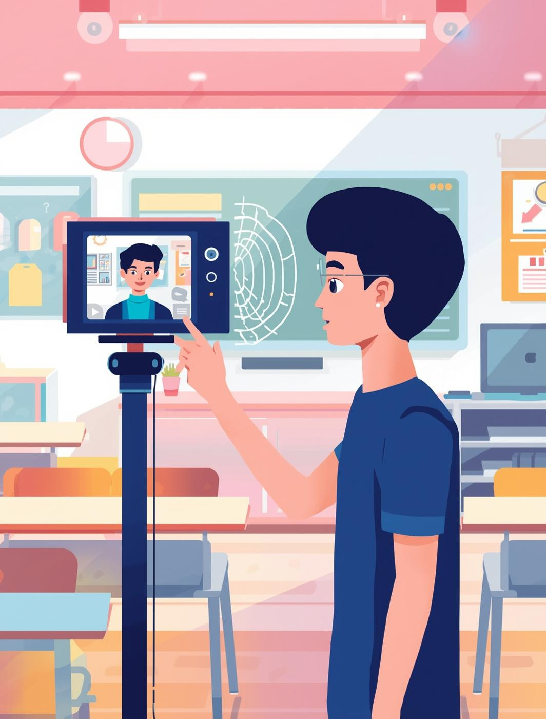
Introduction to AI Attendance
Enhancing attendance systems with AI face recognition technology
The growing need for accuracy, efficiency, and security in attendance management has highlighted the limitations of traditional methods such as manual registers and RFID-based systems. These approaches are often time-consuming, prone to human error, and vulnerable to proxy attendance. With advancements in artificial intelligence and computer vision, face recognition presents a reliable and automated alternative to streamline this process.
This project proposes the development of an AI-based Attendance Tracker that uses real-time face detection and recognition to automatically record attendance. By integrating machine learning models with a robust database and a user-friendly interface, the system aims to provide a faster, more transparent, and highly accurate solution for educational institutions and workplaces.

Slide 4



Objectives
Automate Attendance
Minimize Errors
Real-Time Reporting
Streamline attendance processes using face recognition.
Reduce manual errors in attendance recording.
Provide instant updates on attendance status.

Slide 5
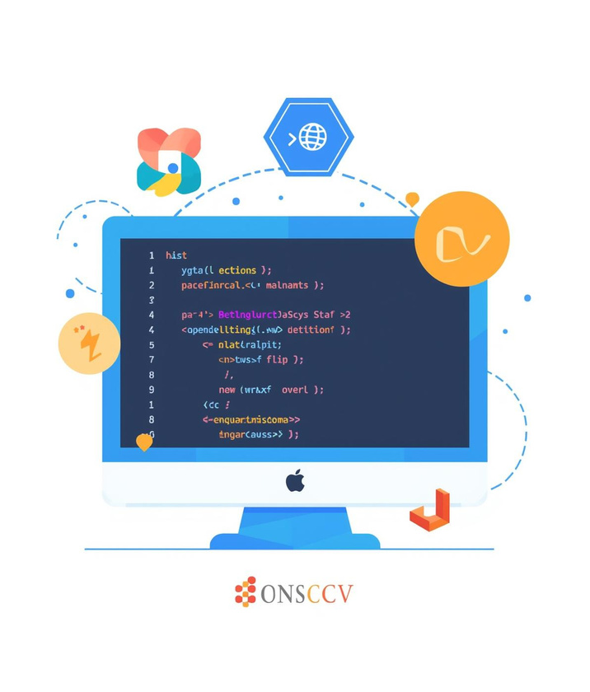

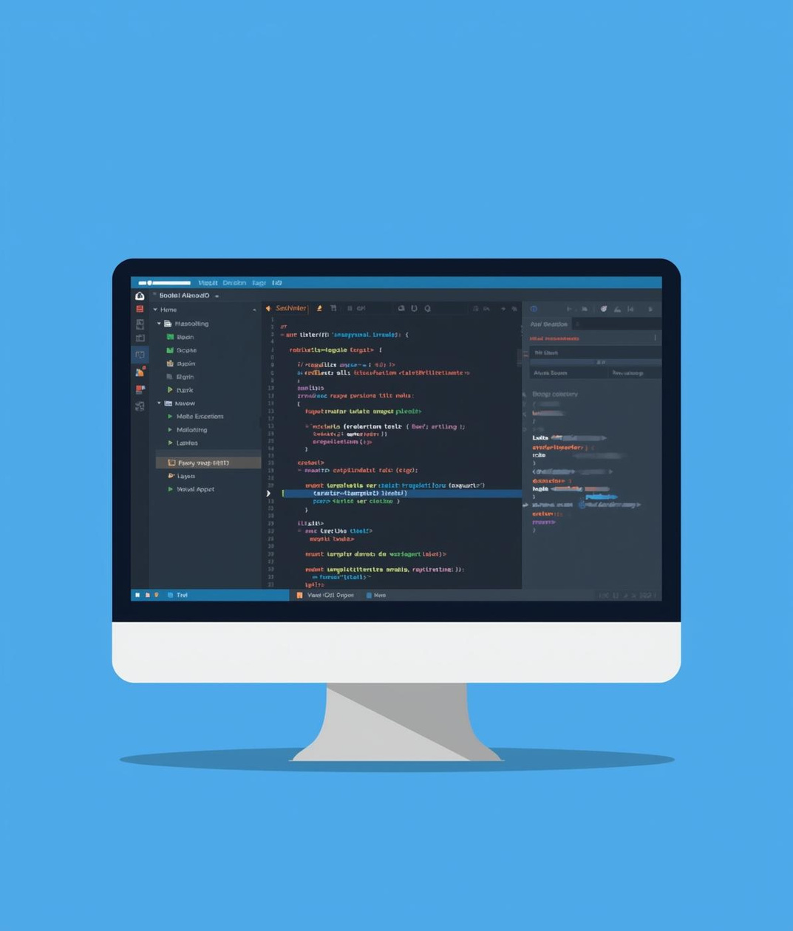
Software and Hardware Components
Software
Hardware
IDE
Tools include Python and OpenCV libraries.
A laptop with a webcam is essential.
Visual Studio Code is the chosen IDE.

Slide 6

Tools Used
  Python – Core programming language
  OpenCV (Haar Cascade) – Face detection
  Vision Transformer (ViT) – Face recognition
  Flask – Web application framework
  Database (CSV) – Attendance storage
  Web Camera – Image and video capture

Slide 7


Methodology: Data Collection and Processing
Data Collection
  Capture live video/image input from camera
  Detect faces using Haar Cascade algorithm
  Preprocess detected faces (resize, normalize)
  Extract facial features using Vision Transformer (ViT)
  Match faces with stored database for identification
  Mark and store attendance in the database
  Display results through Flask-based web application

Slide 8

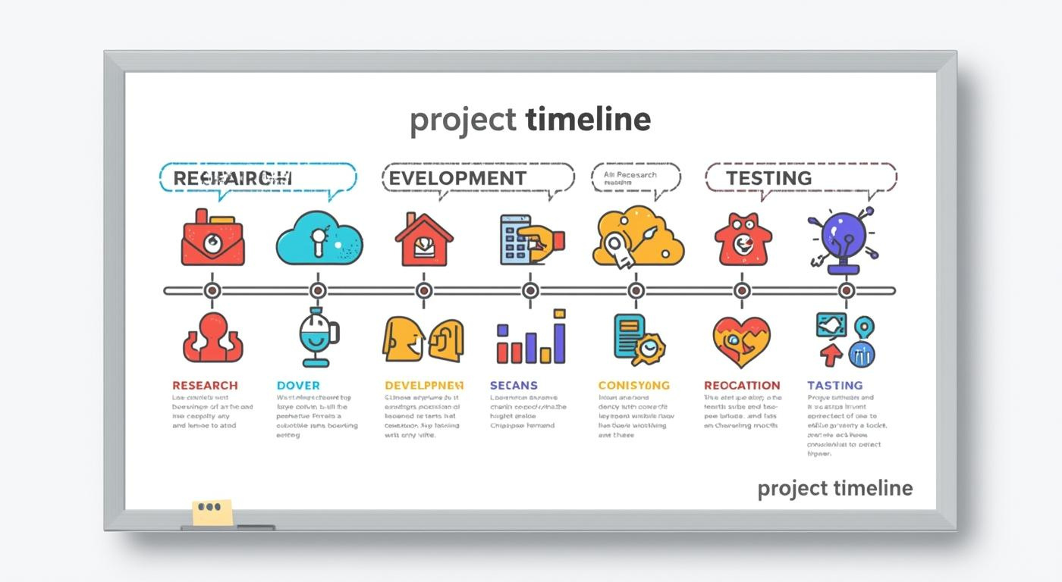
Results and Discussion
  The system successfully detected and recognized faces in real time using Haar Cascade and Vision Transformer.
  High recognition accuracy was achieved under normal lighting conditions.
  The automated system reduced manual effort and proxy attendance effectively.
  Attendance records were accurately stored and retrieved through the Flask-based web application.
  The system showed fast response time, making it suitable for classroom environments.
  Performance may vary under poor lighting or occlusions, indicating scope for future improvement.

Slide 9
Thank You

